Slide 1

















Enhancing Your Relationship With Your Children

Slide 2


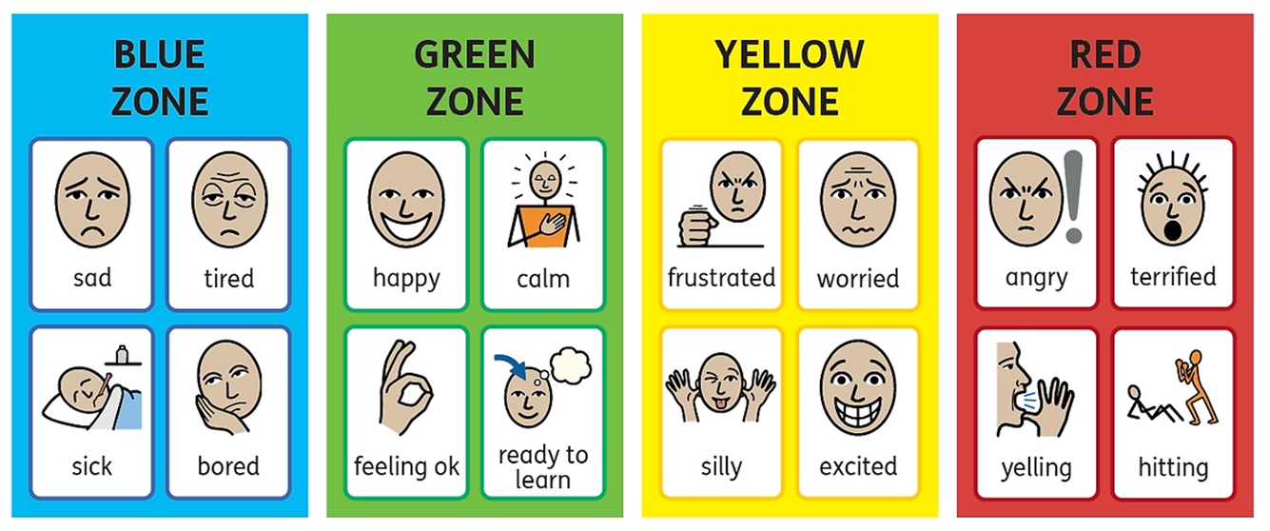


How are you?
Low energy
Good level of energy
A little too much
Too much energy

Slide 3

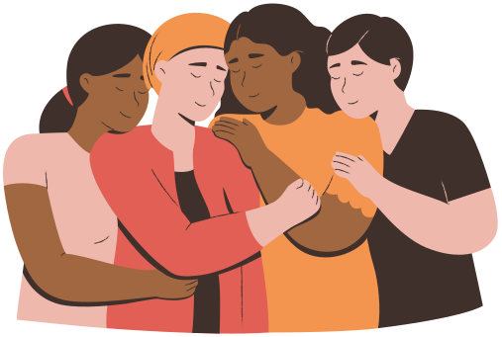
What is your relationship with your child?
This is a non-judgemental space - what you want to share is up to you

Slide 4
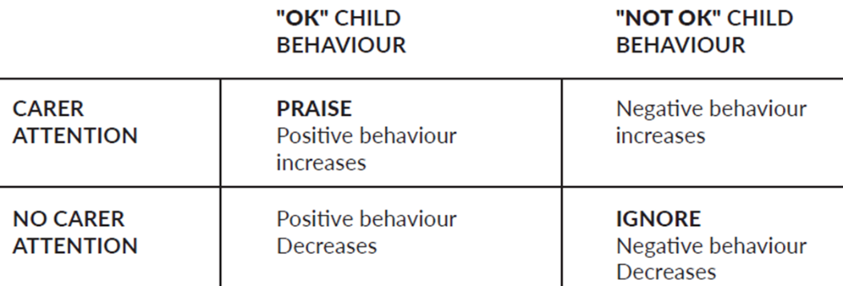


ATTENTION - HOW DO CHILDREN LEARN FROM EXPERIENCE?
SOCIAL LEARNING THEORY:
  Reinforcement: behaviour that is praised/punished is more likely to happen again
  Attention: behaviour is often a way of gaining attention

Slide 5


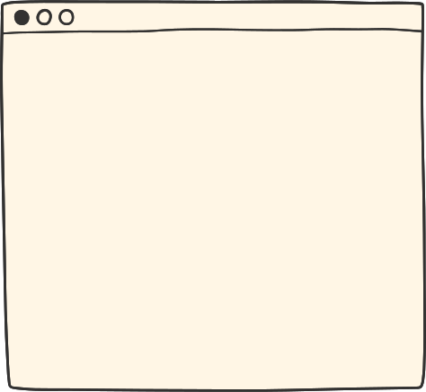
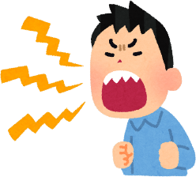


PARENT TRAP
Parent gives instruction
1.Child listens - parent learns shouting = effective
OR
2. Parent gives up - child learns if they continue for long enough, parent will give up = they will not have to do what they are asked
Child screams and resists
Parent shouts
Situation escalates until..
Notes:
https://youtu.be/FfSbWc3O_5M
Anxiety video to show parents - 2 mins long

Slide 6
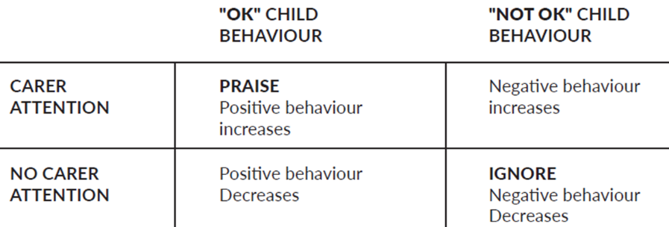


Remember...
  Negative attention lets your child know you do not like what they have done - this can look like scolding, correcting, yelling
  Two key things to keep in mind:
    ANY ATTENTION (positive or negative) after a behaviour increases chance that behaviour will happen again
    Negative attention becomes a problem if used MORE than positive attention

Slide 7
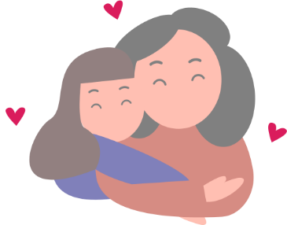



What is your child’s love language vs yours?
Love languages - how we express and receive love
Physical touch: cuddles and kisses, sitting next to you
Words of affirmation: loving words or praise
Acts of service: doing things like cooking their favourite meal
Gifts: special surprises/toys/presents
Quality time: distraction-free time together

Slide 8

You are your child’s safe space... you are home
In order for your child to open up, you need to work on creating the safe space and bond where your child feels comfortable to express themselves
Boundaries
Fun

Slide 9
3 things to communicate with your child...
  PRAISE - when they do something right or things they do well
  ATTENTION - try to give them full attention, this will help you understand what they are telling you - make them feel you care about what they have to say
  SPECIAL TIME - set some time each day to play with your child - lets them know they are important & strengthens the bond between you two

Slide 10
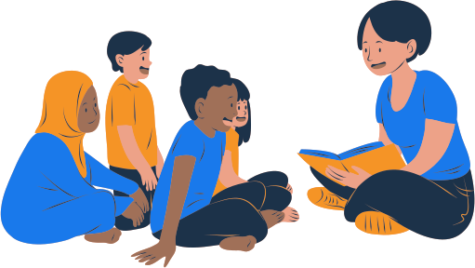
How do you show you are listening / attending to your child?
Notes:
How are you showing that you are listening to your child?
They need visual cues, your ears may be open but is your body language showing something else?
Reflection - one way you are listening to your child - reflecting back to them what they have said and checking you got it right

Slide 11
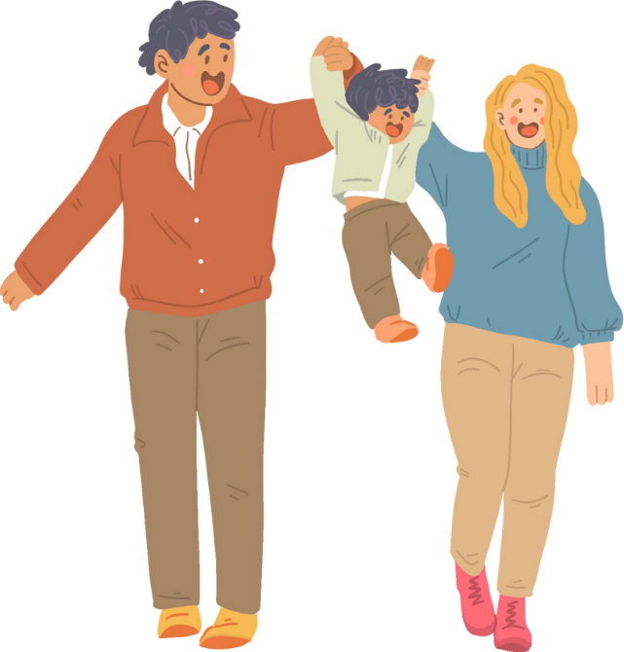
ATTENDING / SPECIAL TIME
Planning in time where you are doing something
with your child is called special time or attending
Attending - providing your child with your
undivided attention for 10-15 minutes, letting them
lead with the activity they
Positive quality time and a good relationship = strong foundation to overcome difficult times. Special time can strengthen the bond.

Slide 12
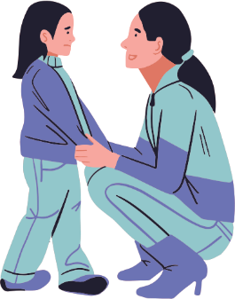

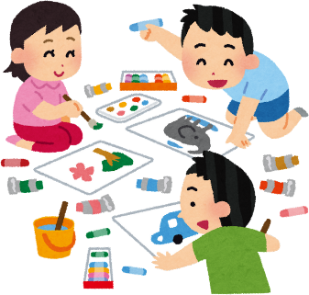
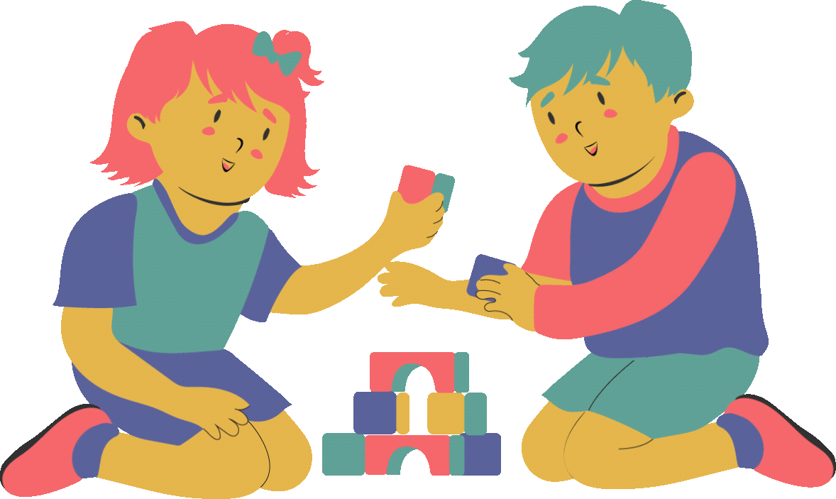
DO...
  Use toys / activities that are not competitive and don’t have right or wrong (e.g. playdoh, drawing, lego, toy animals etc.)
  Give undivided attention - a time when you can focus on your child
  Allow your child to choose the activity
  Follow the child’s lead
  Show interest/amazement/empathy
  Describe what they are doing: action, thoughts, emotions
Notes:
Safety behaviours are helpful when the concern is real and behaviour can reduce danger.
When safety behaviours are used on worries than actual dangers, it keeps the fear and worry going.
Some examples...
Avoidance: if we have strong beliefs that something bad is going to happen in a particular situation, only natural we we want to avoid.
Avoidance is not running away, but using behaviours to block what we are worried about. (e.g. child worried about test, put head down and not do it, avoid school that day, pick a fight - knowing they will be removed from doing the test)
Avoidance doesn't allow children to learn about what might actually happen - so they continue to think about situation in negative way.
We want children to gradually drop their safety behaviours to break the anxious cycle. this is something that you can do gradually by helping them face their fears.
Reassurance: some children want reassurance, natural for parents to want to provide it. Becomes an issue when seeking reassurance frequently, or it is offered frequently, and prevents them from testing anxieties.

Slide 13

ACTION, THOUGHTS, EMOTION
  ACTION: “you got the red brick and you’re balancing it on top of the blue brick” / “you’re pushing the car so fast on the road” / “you’re working on this so carefully”
  THOUGHT: “you’re thinking really hard about how to fit that together” / “you’re working out what to do next”
  EMOTION: “you look so proud of your tower” / “you’re staying so calm, even though its tricky”
Notes:
Commenting is a great way to show interest in what our children are doing - without requiring them to take themselves away from the activity to respond
dont worry about getting things wrong - they will correct you if thats not how they feel or what theyre doing
focus on a range of comments including thoughts and emotions - action only comments can seem a little odd
Match pace of comments with their activity - if they are more active, they may need more comments and vice versa

Slide 14


DON’T…
  Take charge / change activity - allow them to explore, try new things and develop confidence
  Give commands - we want the ideas and problem-solving from them
  Ask questions - could interrupt the flow of the activity and thoughts, they end up following our lead
  Teaching - avoid steering them to what you want them to learn
  Criticising - might lower confidence and fun, no right or wrong when playing
  Compete - if they want to build/create with you, avoid “winning/the best” - do not put yourself down to make them feel better
Notes:
Safety behaviours are helpful when the concern is real and behaviour can reduce danger.
When safety behaviours are used on worries than actual dangers, it keeps the fear and worry going.
Some examples...
Avoidance: if we have strong beliefs that something bad is going to happen in a particular situation, only natural we we want to avoid.
Avoidance is not running away, but using behaviours to block what we are worried about. (e.g. child worried about test, put head down and not do it, avoid school that day, pick a fight - knowing they will be removed from doing the test)
Avoidance doesn't allow children to learn about what might actually happen - so they continue to think about situation in negative way.
We want children to gradually drop their safety behaviours to break the anxious cycle. this is something that you can do gradually by helping them face their fears.
Reassurance: some children want reassurance, natural for parents to want to provide it. Becomes an issue when seeking reassurance frequently, or it is offered frequently, and prevents them from testing anxieties.

Slide 15
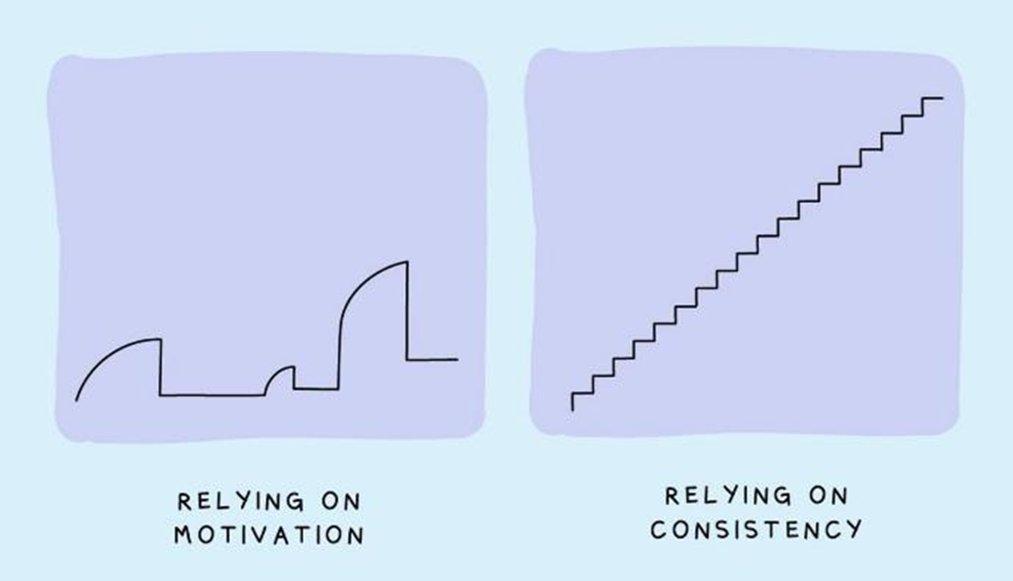
Might not realise at first....

Slide 16
What if...
My child doesn’t want special time to end...
  Play for 10 minutes and give warnings before time ends
  Keep it for 10 mins each day - requires intense and sustained concentration - can be tricky to start with
  You can adapt special time to your child’s age
My child doesn’t want to do special time....
  Is there an activity your child enjoys doing with you already?
My child is misbehaving during special time....
  Praise the behaviour you want to see!
Notes:
Special time feel very fun for children and can feel upsetting when it suddenly ends.
Timer warnings before hand - or a visual clock
Ensure you have the child's attention when you give them this reminder - tell them how long is left and how much you enjoyed this time with them (e.g. Imani, look at me, in two mins, we are going to stop playing, but i really enjoyed playing with you today)
if they say longer, advise you need to stop playing but they can continue to play and you will check back on them (ensure you do this)
important not to increase time of play if they protest, it shows the child that whining and arguing is effective to get your attention

Slide 17
Other ways to enhance the parent-child relationship
  See them as they really are, not what you want them to be
  Let them dream their own dreams
  Avoid saying ‘I told you so’
  Listen, acknowledge, and accept
  Welcome emotions - avoid statements like “big kids don’t cry”
  Slow down and live in the moment
  Bedtime snuggles, stories and chats
  Focus on the positives and not the negatives
Notes:
This is an example of how to gradually support your child with overcoming a fear
Tips:
- Keep repeating steps until child is confident
- Encourage, dont force
- Gradual steps, don't throw them in the deep end
- Make sure child is doing it for long enough
- Reward child for the steps they complete - becomes encouragement to put themselves out their comfort zone and do things that are slightly scary

Slide 18
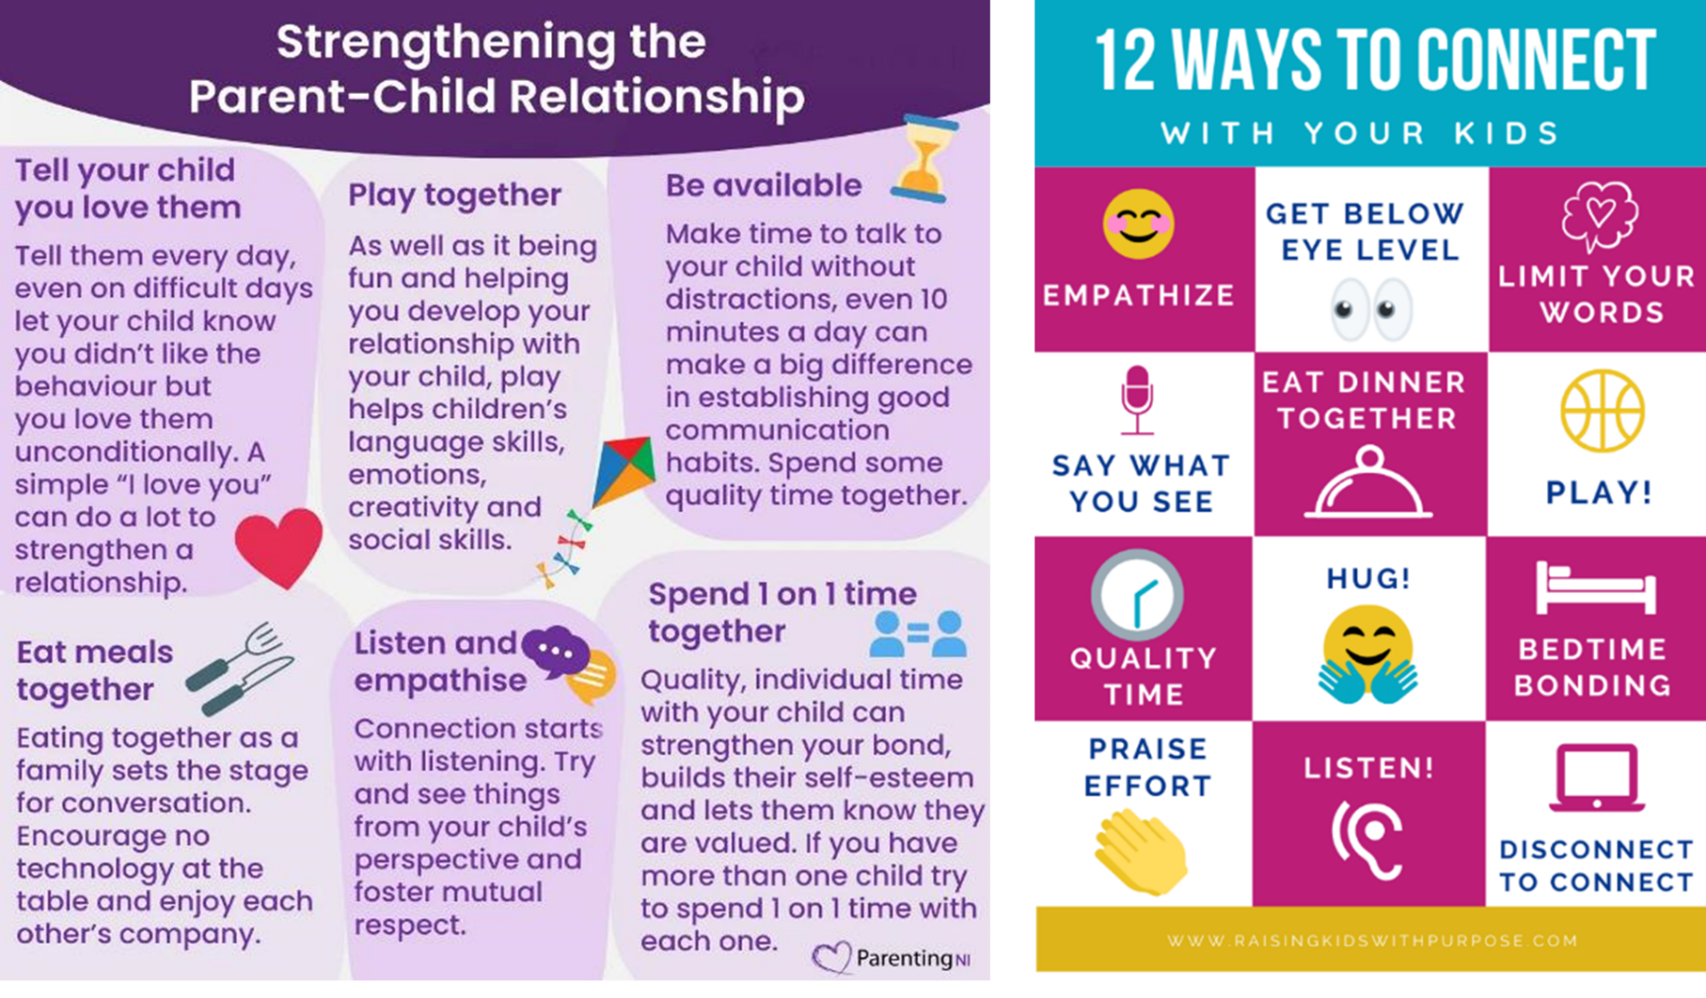
Notes:
Worry tree helps guide children through their worries.
Can have a specific 'worry time' during the day - this is a time that the child knows they can discuss their worries with you.
A clear time where they have your undivided attention, when you dont have somewhere to be (not whilst you want them to get dressed for school)
Not recommended before bedtime

Slide 19
QUESTIONS?
Next workshop:
Supporting my child with Exam Stress
Wednesday 2nd April 2025 9:10-9:50am
For 1-1 support with behaviour problems / fears and worries, please see Ms Ince

Slide 20
Further support
WINS - we work 1-1 with parents who are having difficulties with managing mild-moderate behaviour problems / fears and worries
School - good awareness of your child. They should be able to support your child’s learning and can connect you to services to help the family
  Ms Ince (Safeguarding Lead & Inclusion Lead), child’s class teacher
GP - well trained in physical & mental wellbeing. They are able to suggest ideas and treatment and can refer to specialist services
Young Minds - information supporting children struggling with their wellbeing and empowering families | www.youngminds.org.uk

Slide 21



Further support
PARENT TALK - parenting advice: articles or talking to a parenting coach (WhatsApp, webchat)
www.parents.actionforchildren.org.uk
FAMILY LIVES - parenting advice and support, advice articles on various topics for children of all ages (live chat, email, helpline).
www.familylives.org.uk | 0808 800 2222
ANNA FREUD - resources for children and family wellbeing www.annafreud.org/resources/family-wellbeing

Slide 22
Thank you

