Slide 1

















supporting your child to cope with stress
(and tests!)
Notes:
Whether your child is in Years 4, 5 or 6, preparing for assessments can sometimes feel overwhelming.
We hope to explore what stress and anxiety looks like in children, how we can support them with their learning, and how to build their confidence around learning, assessments and SATs.
We'll also share ideas and strategies that may have worked for other parents!

Slide 2




workshop overview
  Understand stress and anxiety in children
  Learn strategies to support learning and wellbeing
  Discover ways to reduce stress and and build confidence
Notes:
Understanding why children may experience study and test anxiety, followed by strategies to help them develop healthy study habits, and manage stress.
We'll also discuss how to have helpful conversations that reassure and motivate your child
Open up for a discussion where you can share your experience and ask questions

Slide 3
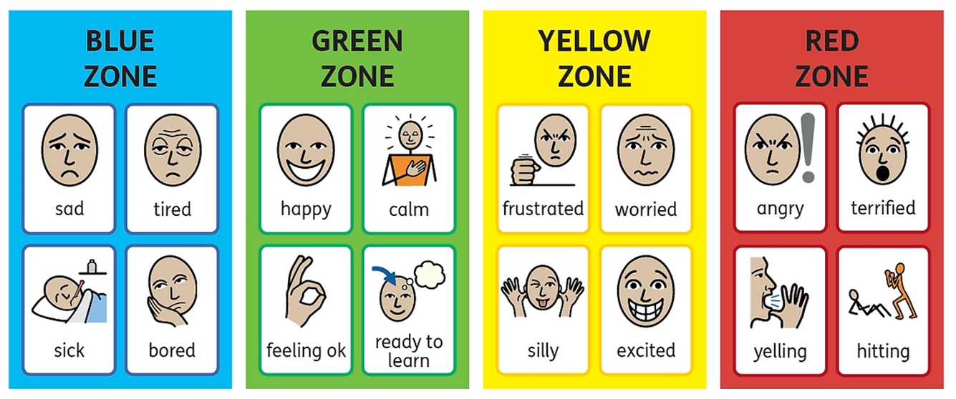
How are you?
Low energy
Good level of energy
A little too much
Too much energy

Slide 4

what are your concerns?
  What are your main concerns about your child’s learning and tests?
  Have you notices any signs of stress or anxiety around school work?
This is a non-judgemental space - what you want to share is up to you
Notes:
Lets start with a discussion.
Have you noticed any changes in their behaviour when studying or talking about tests?

Slide 5


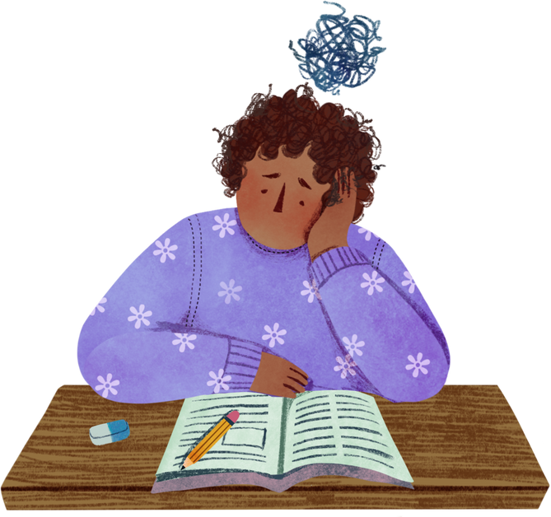
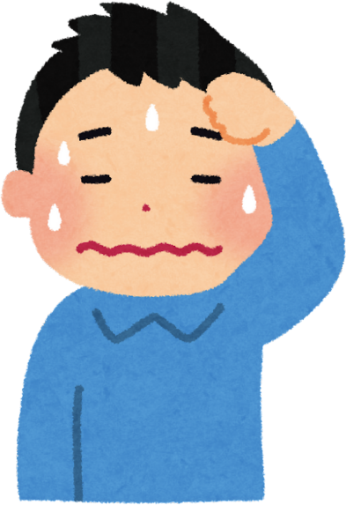
understanding stress and anxiety
What is study / test anxiety?
  Worries about performing well in tests, leading to stress
Common signs: avoiding study / homework, headaches, tummy aches, feeling irritable, trouble sleeping
Why does it happen?
  Pressure to do well, fear of failure
  Lack of confidence
  Additional needs, neurodiversity
  Cultural / family expectations
Notes:
Common in children - natural to feel a little nervous but when stress becomes overwhelming - it may impact their learning and wellbeing.
Some children avoid study altogether, others may become irritable/frustrated or complain of physical symptoms.
Every child experiences study and test anxiety differently due to cultural expectations around academic achievement, while others may struggle to focus or process information due to learning needs or neurodiversity such as ADHD or dyslexia. Children may face added stressors if there are fewer resources for support.
Recognising these differences and understanding these signs early allows us to help them develop healthier coping mechanisms and study habits, and help us tailor our support to meet each child's unique needs.

Slide 6
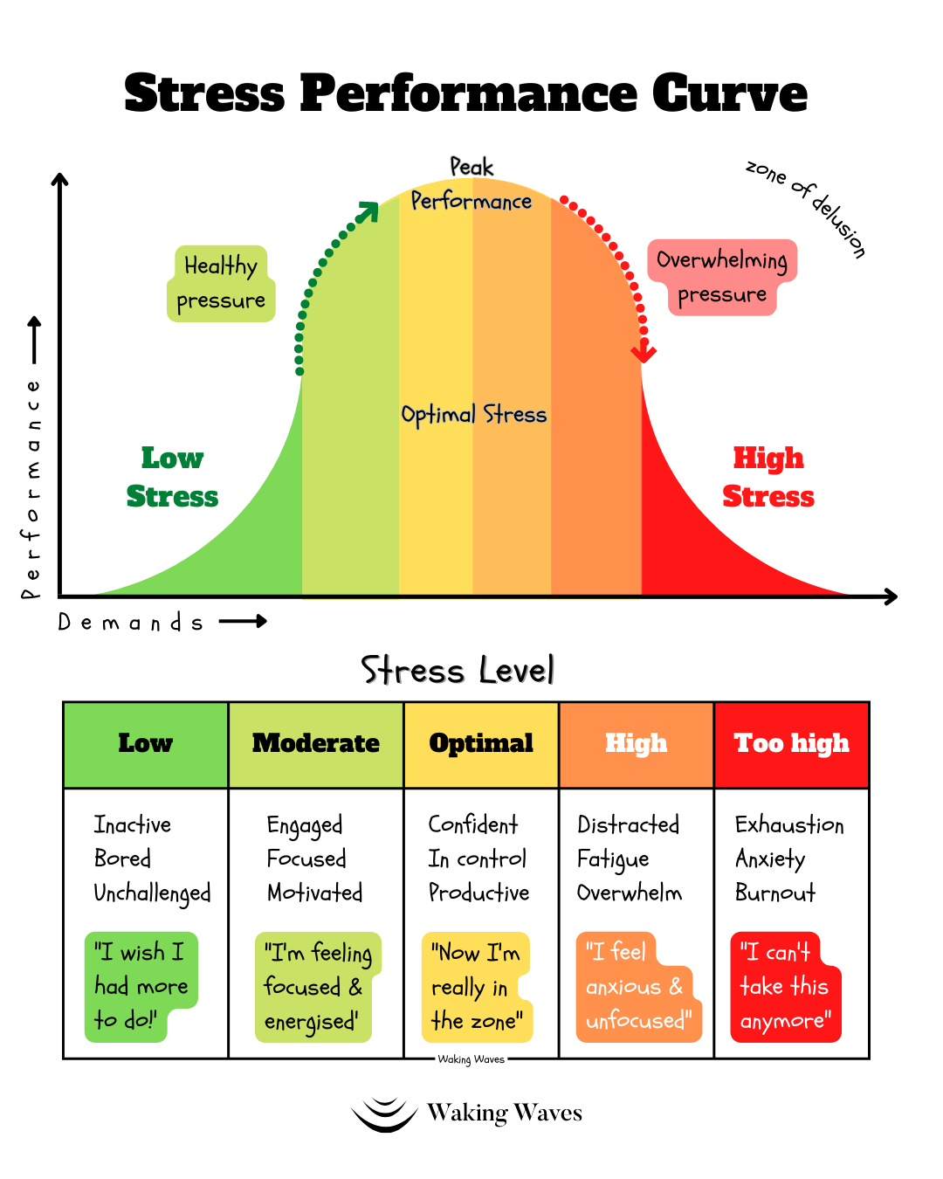
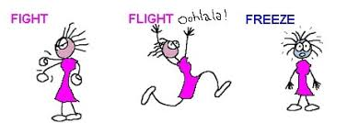
Yerkes-Dodson
  A little stress boosts performance, too much reduces effectiveness
  Growth Mindset (Dweck): abilities can be developed - encouraging effort
Notes:
Some stress can be helpful - motivating children to focus and try their best.
YD Law - small amount of pressure improves performance. but too much can cause anxiety and poor concentration.
As a response to stress / anxiety, we can respond in 3 ways: fight (becoming irritable), flight (avoiding work), freeze (feeling stuck and unable to start).
We can help by shifting the focus from results to effort - known as the growth mindset - instead of saying "you're so smart", we may say "I love how hard you're working on this!"

Slide 7
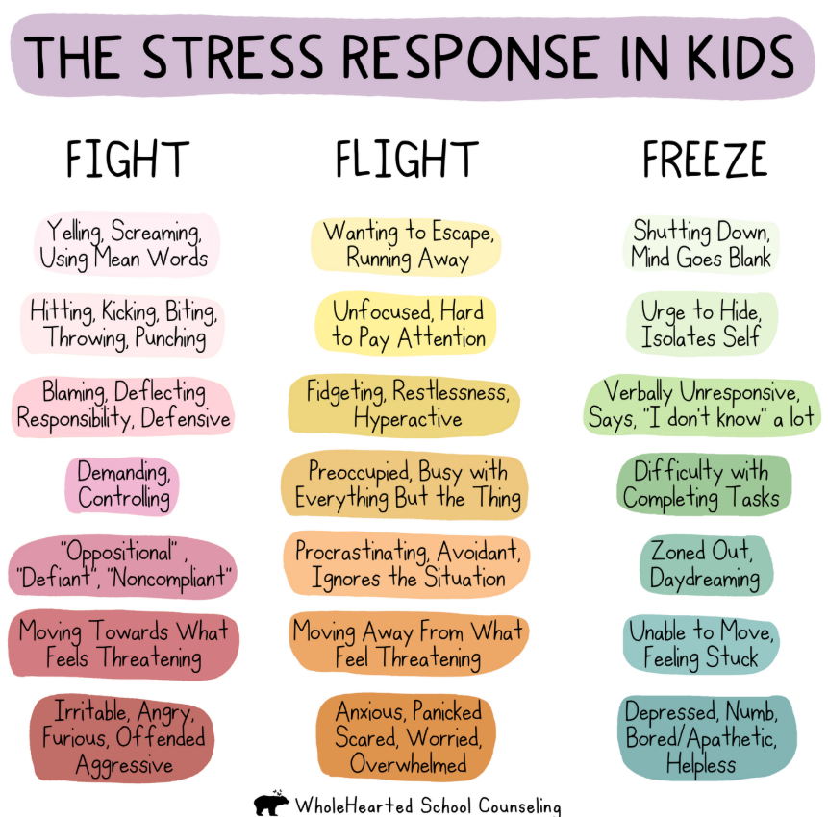
  FFF response can be shaped by personal experience
  Anxiety is felt in our bodies - ask your child if what they feel
Notes:
When we experience stress or anxiety, our body percieves something in our environment which is "dangerous" to us or not safe.
This rings an alarm bell in our minds, and we respond in these three ways. In children, we may see these behaviours.
The response each child adopts is dependent on their personal experience. For example. some feel they may need to prove themselves in exams. Others might have been taught academic success defines their worth, leading to higher stress. By recognising these influences, we can help them feel valued beyond their scores / how well they do with homework.

Slide 8
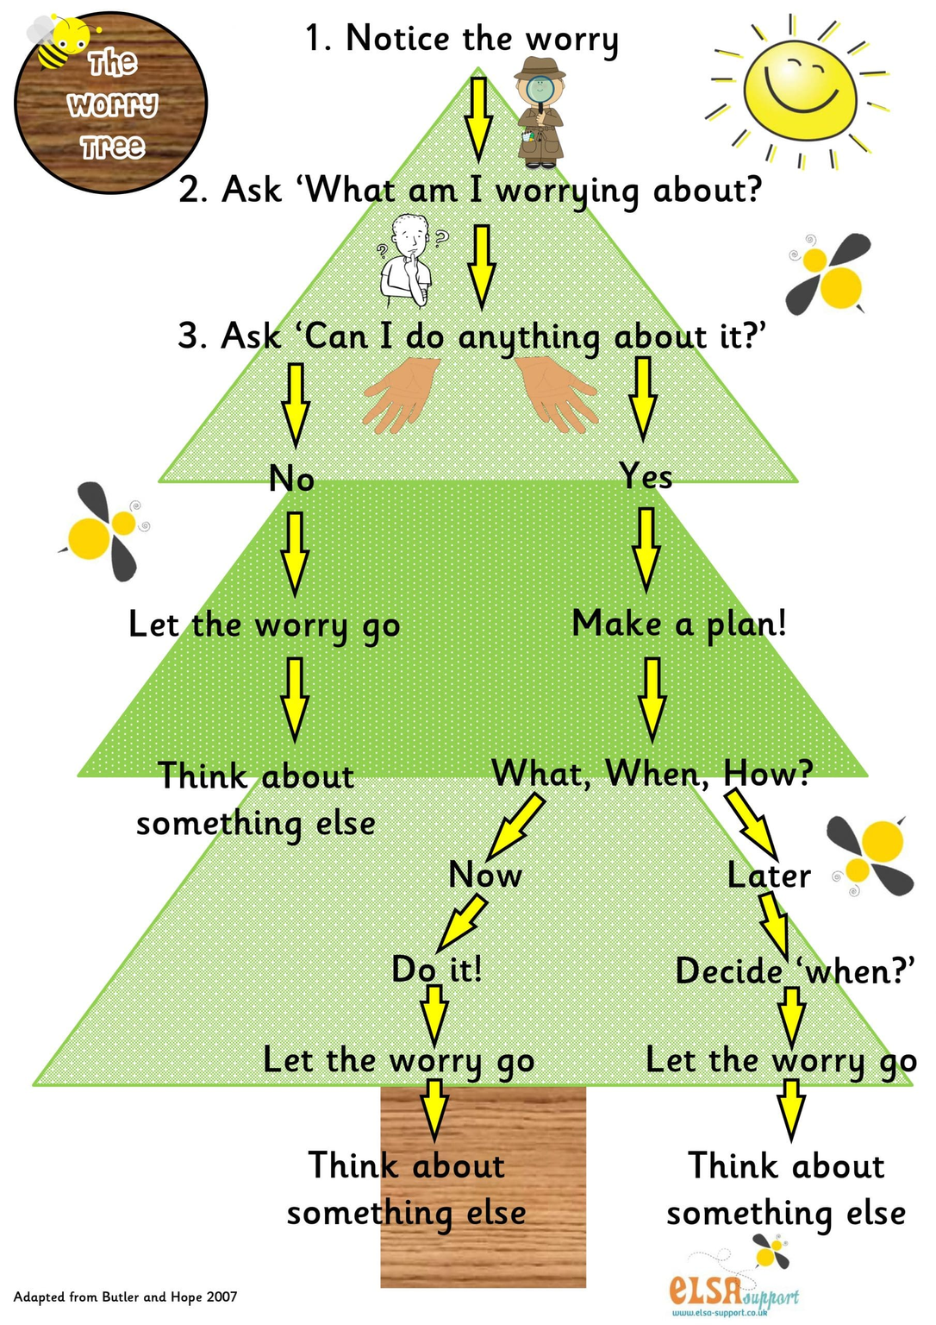
understanding worry & the worry tree
We can use the worry tree to:
  understand their worry
  support their problem solving
  where we can support with implementing strategies
Notes:
Understanding worry.
Sometimes, children may feel worried and not know how to resolve their worry.
We can use the worry tree to understand their worry, support their problem solving and moments where we can support with implementing strategies
Some children may benefit from having a visual tree like this to follow through as you discuss the worry.

Slide 9

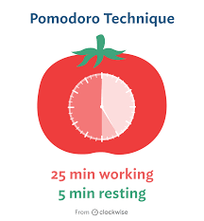
healthy study routines
  Many children struggle with studying because they don’t know where to start, might not understand what they’re required to do or not sure how to break down tasks
  Break study into small, focused sessions
  Pomodoro technique - visual / audio timers
  Encourage active learning (quizzes, flashcards,
teaching someone else)
  Balance work with play and relaxation
Notes:
Instead of long study hours, break this down into small focused sessions. 25 mins + 5 min short break can help maintain focus. Some children may need longer to process information, access to quiet spaces, more frequent breaks - its important to work with teachers to ensure they have what they need.
Active learning - using flashcards, asking them to explain to you, or doing practice questions help them retain information better - they can become the teacher and you are the student!
Encourage your child to use strategies that work for them, whether that's visualisation techniques, extra reading time or even small sensory tools to help with focus.
Balance is key! Encourage play, movement and relaxation to prevent burnout

Slide 10

MANAGING ANXIETY - before & DURING
Practicing strategies when they are calm will help them learn what helps when stressed!
Before the stressful event:
  Practice calming techniques (breathing, mindfulness)
  Normalise mistakes - mistakes as learning opportunities
  Positive self-talk (“I can do my best”, “I got this!”)
  “Whats in my control” - boost confidence
  During the stressful event: Deep breaths, reading things carefully and coming back to the tricky tasks later
Notes:
Test and study stress often start before the test/study itself.
Help your child practice strategies when they are in the "green zone" so they are able to understand what this feels like in their body, their mind.
Relaxation techniques like deep breathing, mindfulness to help them stay calm. Empower them that they have control.
Reassure them that mistakes are a part of learning, perfection isn't the goal, effort is! If they are feeling really overwhelmed, some things are just not in our control! asking them what they would have control over vs what they dont may help ease their worries
On the day of test / handing in homework, encourage them to practice deep breaths if they feel nervous, read questions slowly, and come back to the tricky parts later (your brain has time to think whilst you're working on other things).
These small strategies can help make a big difference!

Slide 11
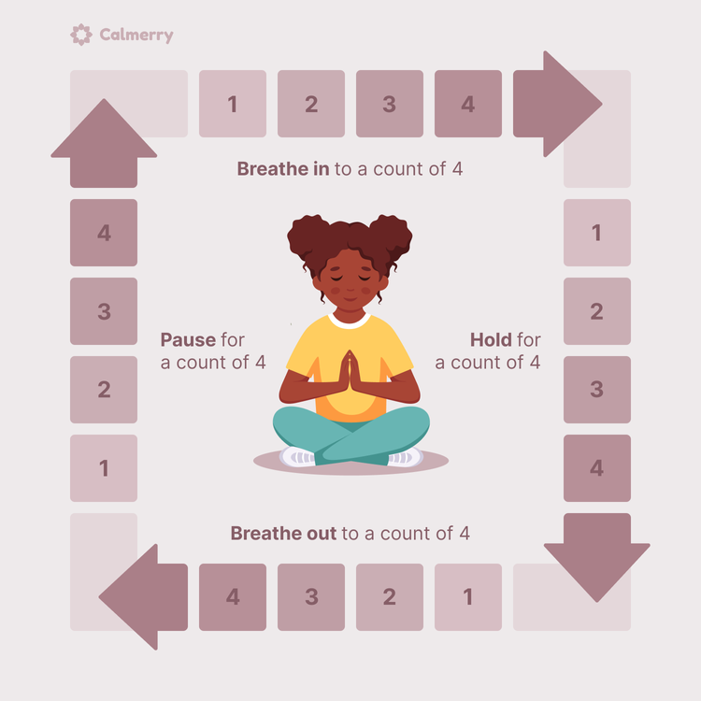
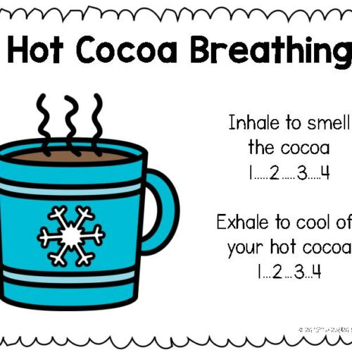
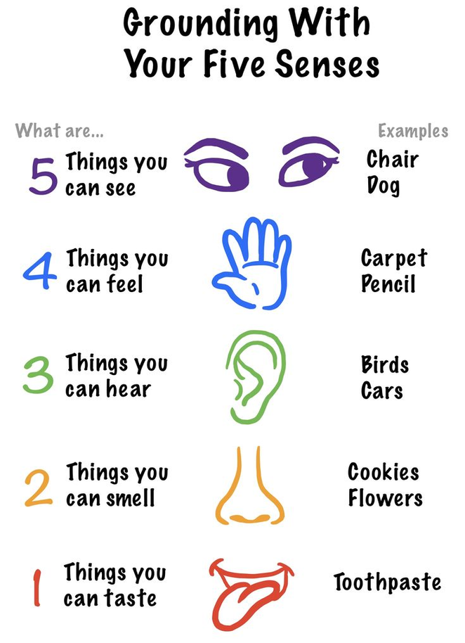
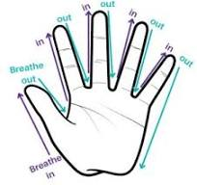
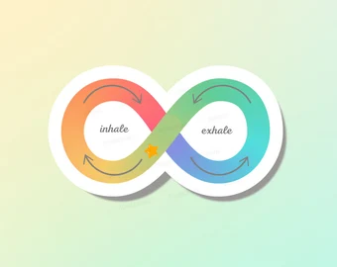
Relaxation & grounding techniques
Notes:
Pair up together and practice guiding your child with the strategies
- once you recognise they have calmed down, ask them how it feels in their body or anything that has changed in their body compared to before

Slide 12


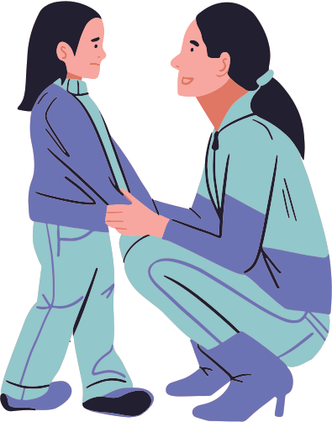
how to talk to your child about stress
DO...
DON’T...
  Validate emotions
    “I can see you’re nervous and thats okay...”
  Ask open ended questions
    “I wonder how it feels when...”
  Reassure effort over results
    “I am proud of you for trying so hard!”
  Overemphasise results
  Compare to others
  Dismiss their feelings
Notes:
What we say to our children about stressful situations can influence how they feel. In some cultures, academic success is deeply tied to family expectations, which can add pressure for children to perform well. Some children may worry about disappointing their family, whilsr tohers might struggle if they aren’t receiving the same encouragement as their peers.
Very normal for us to sometimes say "don't worry its just a test" - instead, acknowledging and validating their feelings can help (e.g. I can see you're nervous, and thats okay"
Open ended questions: "how do you feel about the work/test/revision?"
Importantly, focus on efforts, let them know you're proud of them no matter what – by creating a supportive space where they know their effort matters more than their results is what matters most!

Slide 13

Lets practice!
In pairs...
One parent plays the child expressing their worry around homework / tests
One parent practice responding with supportive techniques
Techniques: worry tree, validation, open ended Qs, relaxation / grounding, reassurance and praise
Notes:
Lets practice!
In pairs, one of you will play the child, the other will respond using supportive language.
Then switch roles, and we'll share what worked well and felt most reassuring.

Slide 14

sharing ideas...
  How did it feel doing the practice? What helped? What might you do differently?
Every child is different... You are the experts of your child and know how to communicate with them during stressful times!
  What strategies have worked for your child?
  What challenges do you still face?
  How do family values and cultural backgrounds shape the way we talk about education and tests?
Notes:
Different families have different ways of approaching education, and this can sometimes shape the way children view education and tests. Some children may feel pressure to achieve high grades because of cultural expectations, while others may struggle if they feel their unique learning style and needs aren’t recognized.
Takeaway: each child is different and different strategies may help, some children may find comfort from conversation, some may comfort from guided relaxation. What external factors might be shaping your child’s feelings about studying?
Note: avoid discussions about worries before bedtime, advised to do this a few hours before they go to sleep and they have your undivided attention.

Slide 15
summary & takeaway
  Balance study with relaxation - routine!
  Use worry tree to understand and guide conversations about worry
  Validate feelings and encourage a growth mindset
  Teach simple stress-management techniques
  Keep conversations supportive and pressure free
  Avoid conversations about worry before bedtime
Notes:
To wrap up, remember a balanced routine is key.
Using the worry tree can help us understand and reflect back what our children are worried about.
Validating emotions helps feel children feel heard, and ease anxiety.
Keeping conversations about homeworks and tests positive and support goes a long way - your encouragement as a parent is what matters most

Slide 16
Further support
WINS - we work 1-1 with parents who are having difficulties with managing mild-moderate behaviour problems / fears and worries
School - good awareness of your child. They should be able to support your child’s learning and can connect you to services to help the family
  Inclusion Lead (Ms Patel), class teacher
GP - well trained in physical & mental wellbeing. They are able to suggest ideas and treatment and can refer to specialist services
Young Minds - information supporting children struggling with their wellbeing and empowering families | www.youngminds.org.uk

Slide 17



Further support
PARENT TALK - parenting advice: articles or talking to a parenting coach (WhatsApp, webchat)
www.parents.actionforchildren.org.uk/
FAMILY LIVES - parenting advice and support, advice articles on various topics for children of all ages (live chat, email, helpline).
www.familylives.org.uk | 0808 800 2222
ANNA FREUD - resources for children and family wellbeing www.annafreud.org/resources/family-wellbeing

Slide 18
QUESTIONS?
Next workshop:
Managing my child’s behaviour at home
Tuesday 22nd April @ 2:10-2:50pm
For 1-1 support with behaviour problems / fears and worries, please see Ms Patel

Slide 19
Thank you very much

